Slide 1
Prototype voting board

Slide 2
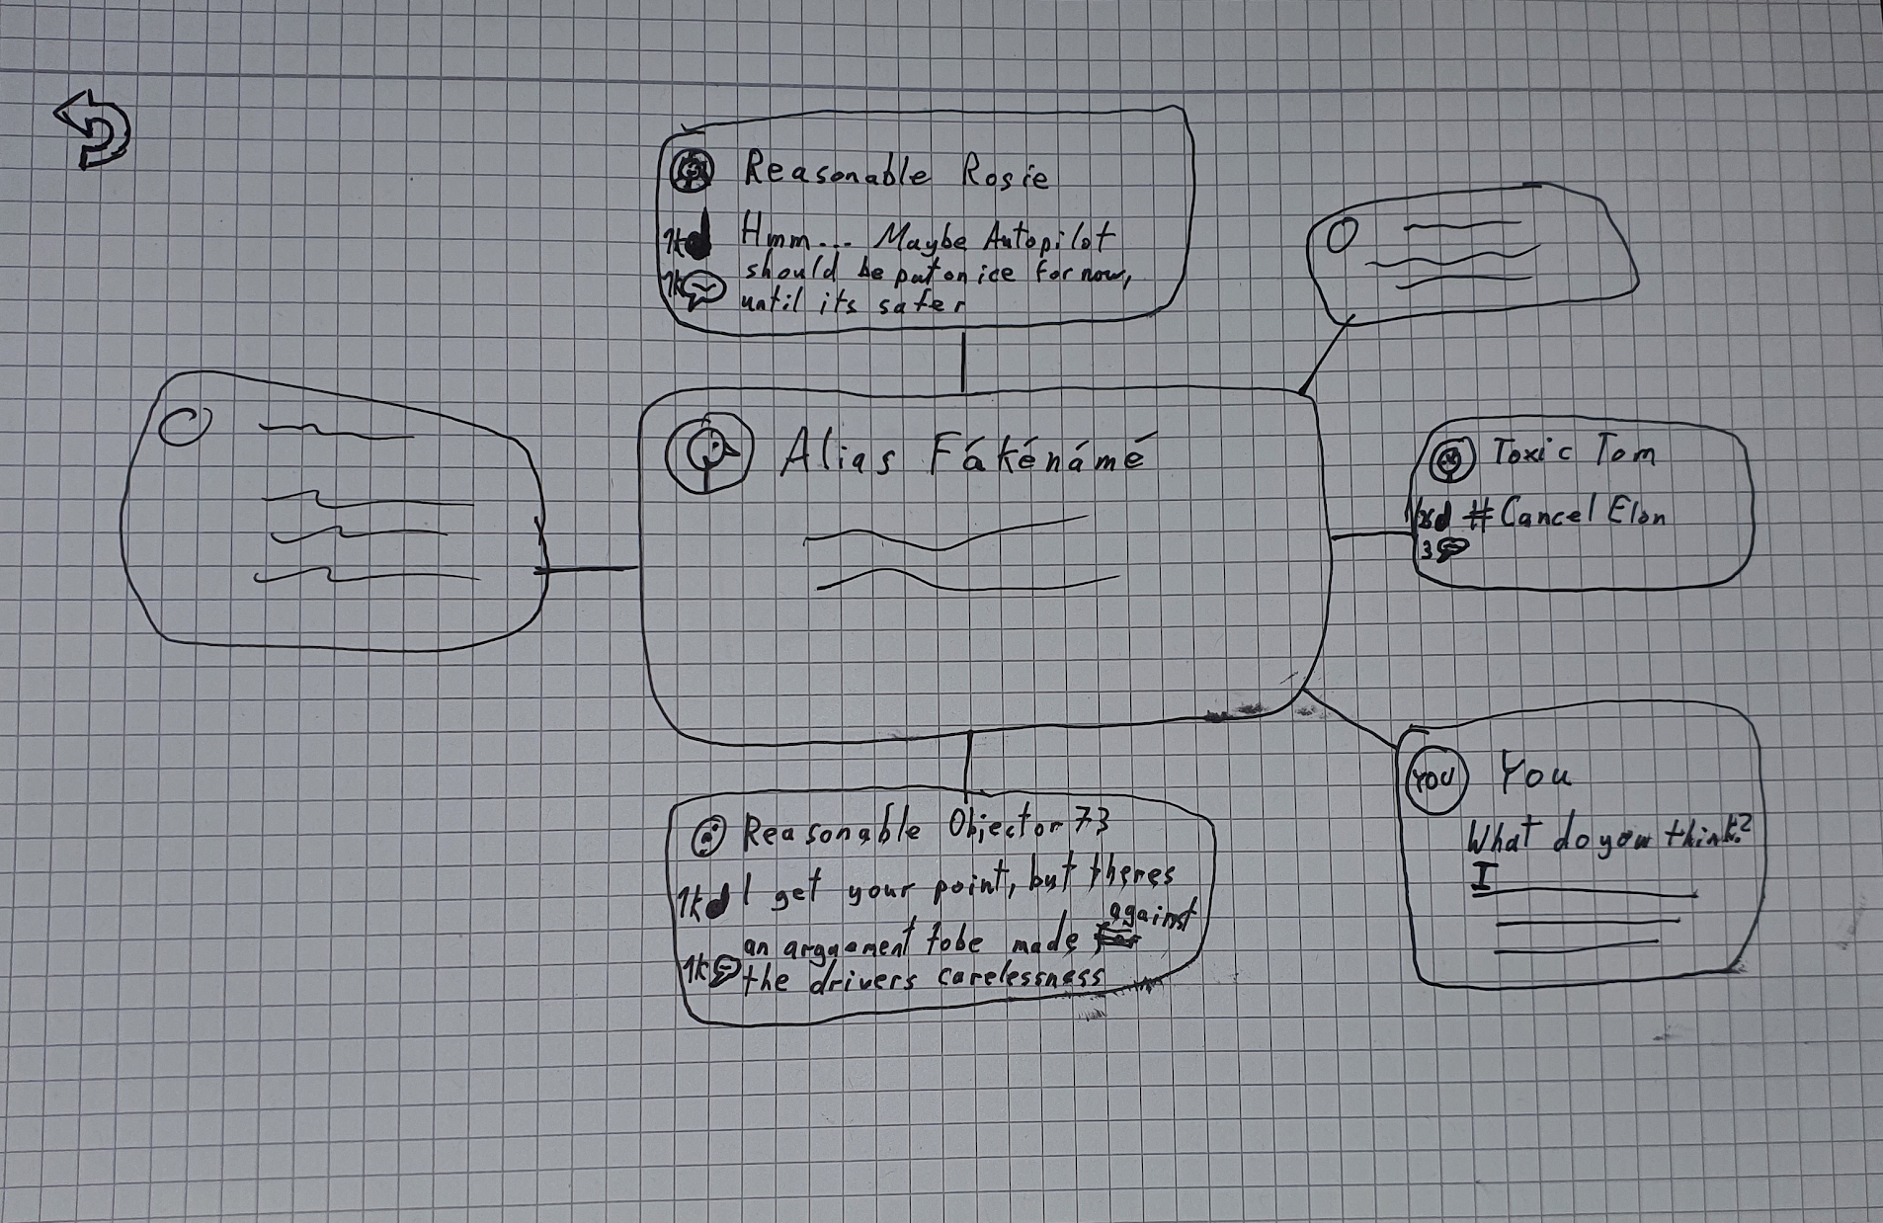
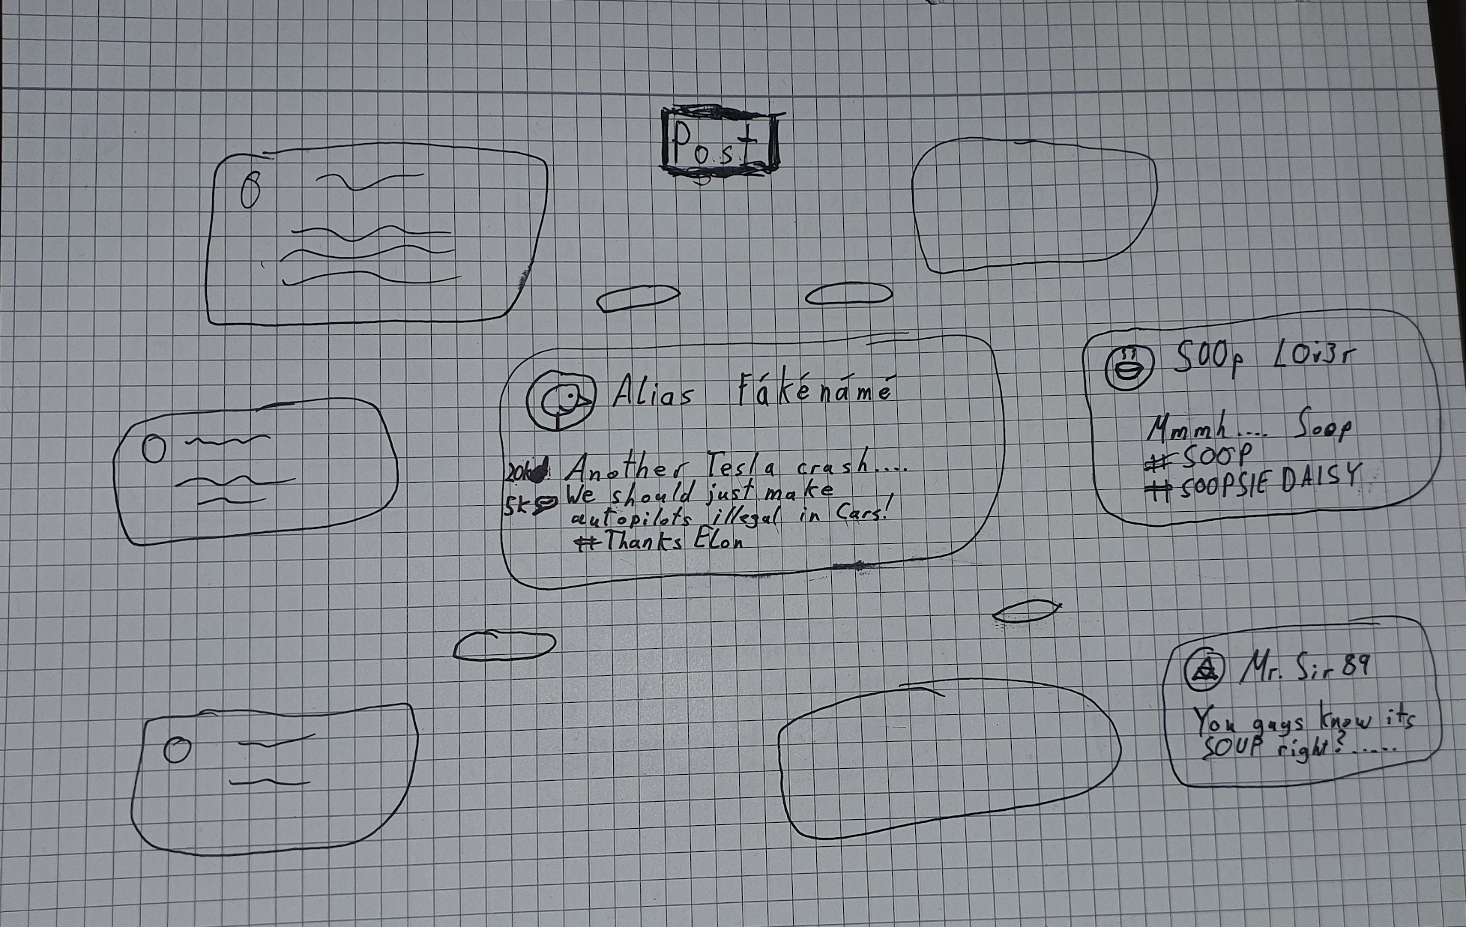
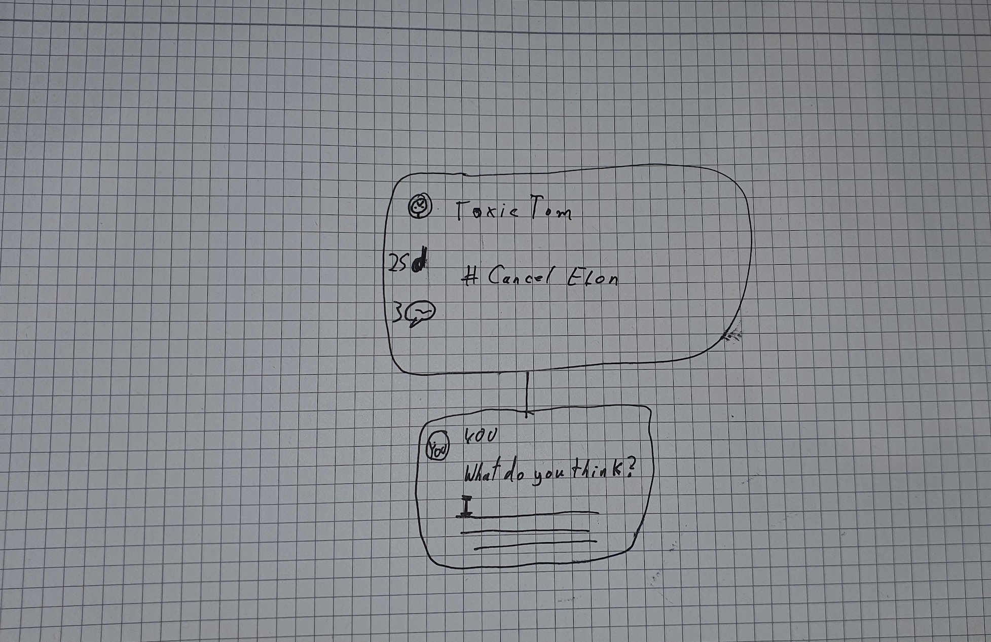
Spiderweb System
Navigate 1
Splash-Page
Navigate 2

Slide 3
Spiderweb System
Pro’s:
Size of posts vary depending on the amount of interaction a post has, comments could be worth more than likes for instance
Visually it is quite clean and appealing, especially considering its novel nature
Relatively easy to navigate
The actual design is straight forward without losing complexity, so the coding would not be too cumbersome
Can easily be scaled for mobile phones, so there’s no need for a “mobile version”
Con’s:
Can arguably become tedious to navigate if too much “fluff” is added (like animations that take too long)
If the interaction factor is not coded properly, certain types of posts may always be preferred
Quite design intensive
Navigating posts may have a slightly different interface form pages like “settings”
There might be a scenario that the differences between the likes of the top posts and the bottom posts are too large. This causes the sizes of the bottom posts being too small to be displayed on the screen..
Feedback:
I quite like this structure in that it helps to maintain a surface level view of things going on, but also the user can explore different posts, depending on what they are interested in. Instead of the usual randomised algorithm scroll of a usual social media page. However, one of the things I would add, is how would everything be displayed from the surface-level page (as in , it could get quite crowded and difficult to ‘pick’ things out).
Might be hard to implement. Quite a playful and novel approach to social media interaction though. I like the immediate visual display of engagement. I worry that it might be complicated and not immediately obvious how to interact with it.
This is designed in a really interesting way, but I wonder whether it is the most effective in terms of presenting the ‘messages’ of our project clearly. Is the downside of it being an unfamiliar to a use + harder to implement worth it for the pay off? The design is really cool though!

Slide 4
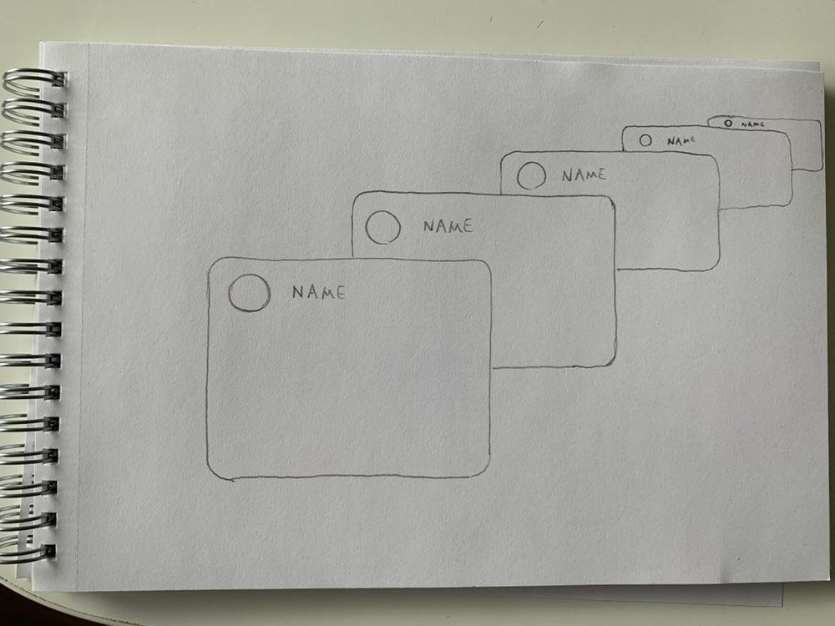
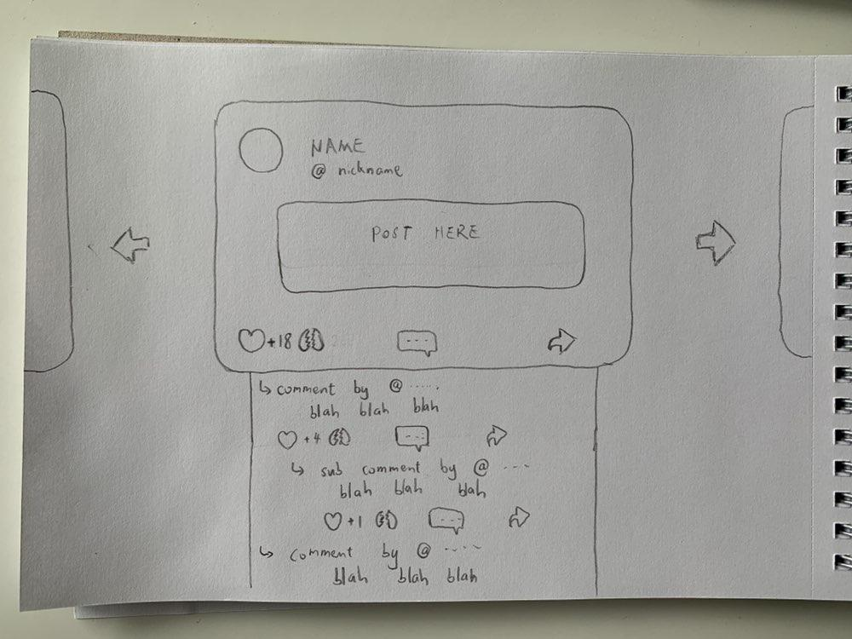
Diagonal scroll system
Explore new posts by scrolling down
After clicking on a post
Comment section very similar to Reddit

Slide 5
Diagonal scroll system
Pro’s:
Should be rather straightfoward to implement
Except the diagonal scrolling, everything else has been done before, so potentially could find apis or existing code implementing these features, therefore reducing the workload.
Users should be easily adjusted to diagonal scrolling.
Con’s:
Sentences usually start from the left, so having the left side of each post blinded makes it harder to predict the content of each post whilst scrolling. An easy improvement to this is to make each post move from top left to bottom right whilst scrolling down, instead of top right to bottom left. However, it might be a disadvantage that this scrolling system is intrinsically not capable of showing the full post unless the post reaches the front.
Some additional animations must be made for moving the oldest post out of screen and the newest post into screen
Comment section looks boring, and is not quite original
Feedback:
Nice visual way of having the posts ‘stacked’ on top of eachother, so that you have an idea of the posts that are coming, instead of the traditional scroll of social media. With your comment about the comment section, we could probably develop this. Since it’s randomised, there’s no really way that the user could pick out what they’d be interested in reading, so I guess maybe a drawback is that the user is forced to read every single one of the posts vs. having an overall surface level view of what’s going on (but maybe this isn’t really a drawback anyways, depending on what you’d be interested in).
I think the design is nice and clean. It’s novel yet familiar and should be reasonably straightforward for a user to work out how to interact with it
Very intuitive as its easy to navigate and users immediately understand how the site works, though it may be a bit too simple visually, which may limit people's enjoyment and (theoretical) long time engagement
A really cool design! I don’t know if it would have to be redesigned to fit on a phone? Could ask the users to hold their phones horizontal instead of vertical

Slide 6
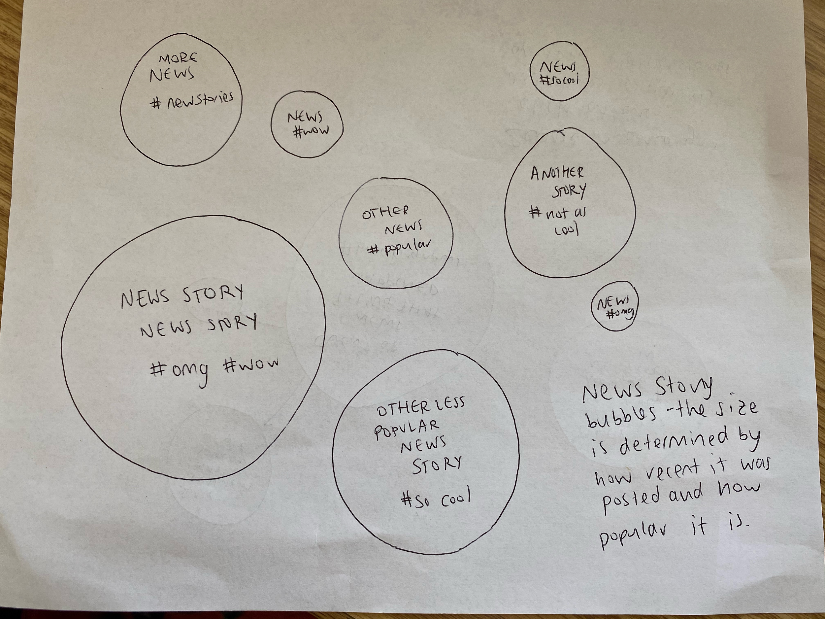
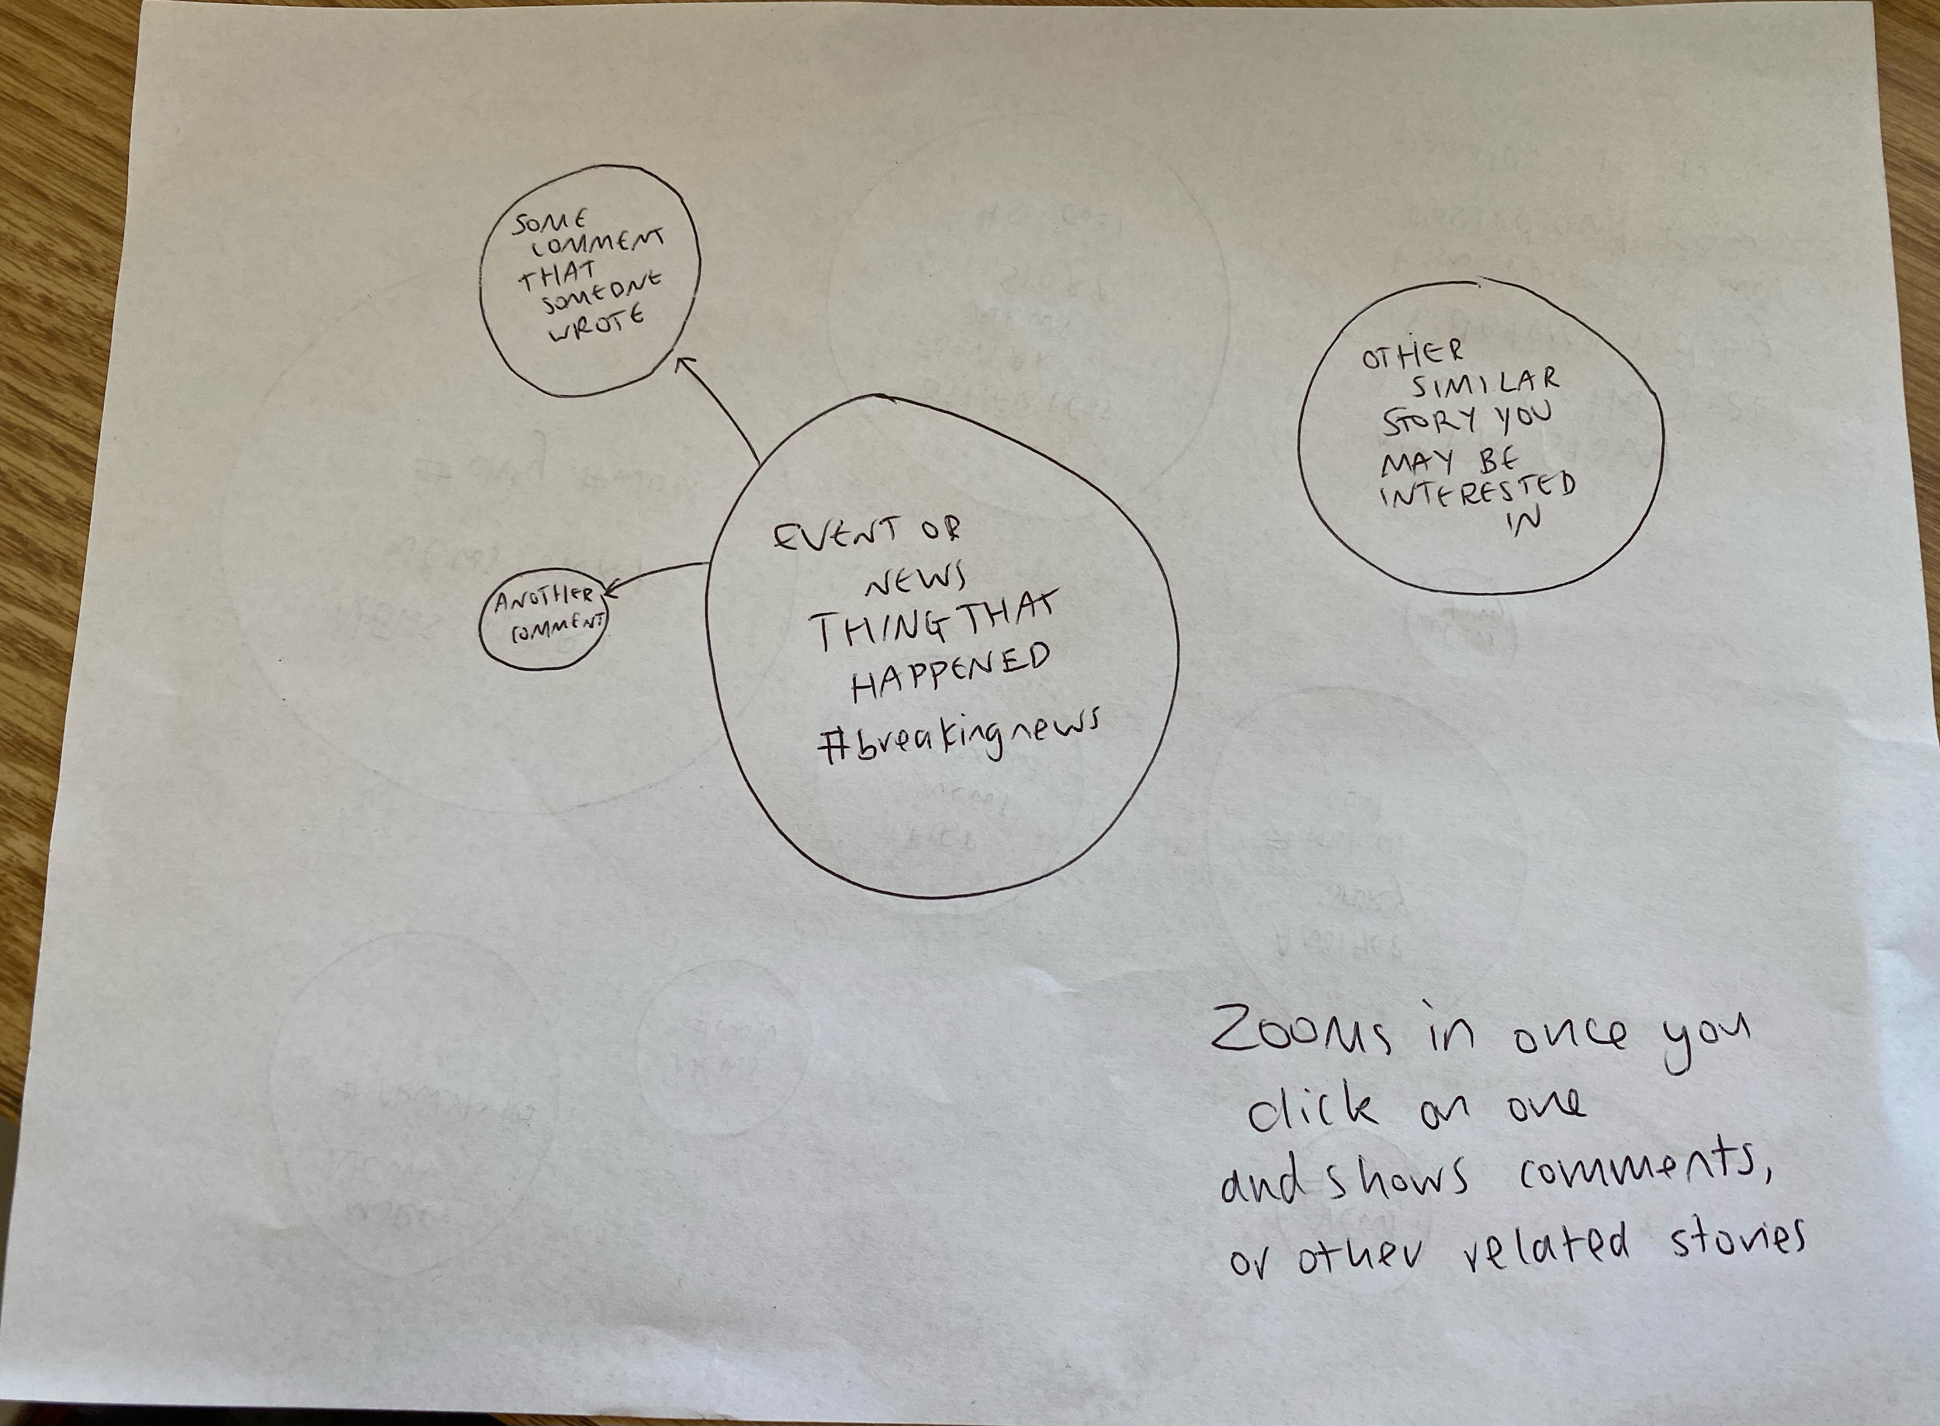
Bubble System

Slide 7
Bubble System
Pro’s:
Whole view of system from a surface level perspective
Quite visual and easy to see what’s going on
Can go down the path that you’d be interested in exploring more, and so naturally tailors the experience to that user and what their interests are
The size could vary depending on the popularity / how recent the post was made
Con’s:
Could be quite confusing
The actual size of bubbles might not be representative to what actually should be the most popular, without some sort of AI/ Machine Learning implementation
Might not be that straightforward to implement
Since its just bots picking how ‘popular’ something is, then it isn’t really a good representation to have a bigger bubble based off of popularity - maybe could be instead based off of how recent?
Feedback:
I think it’s very visually appealing. Might be hard to implement due to animation etc. Quite different to most social media feeds which is interesting, but might confuse users. The visual representation of engagement with posts is cool, but may be hard to balance that with usability (ie how to stop certain posts getting too big / small)
Straight Forward and yet possesses the ability to enable deep engagement, the bubble system is also very interesting to use, and rather unique when compared to other social media sites. It may however end up too simplistic, IF we don't extend its appeal with some more features

Slide 8
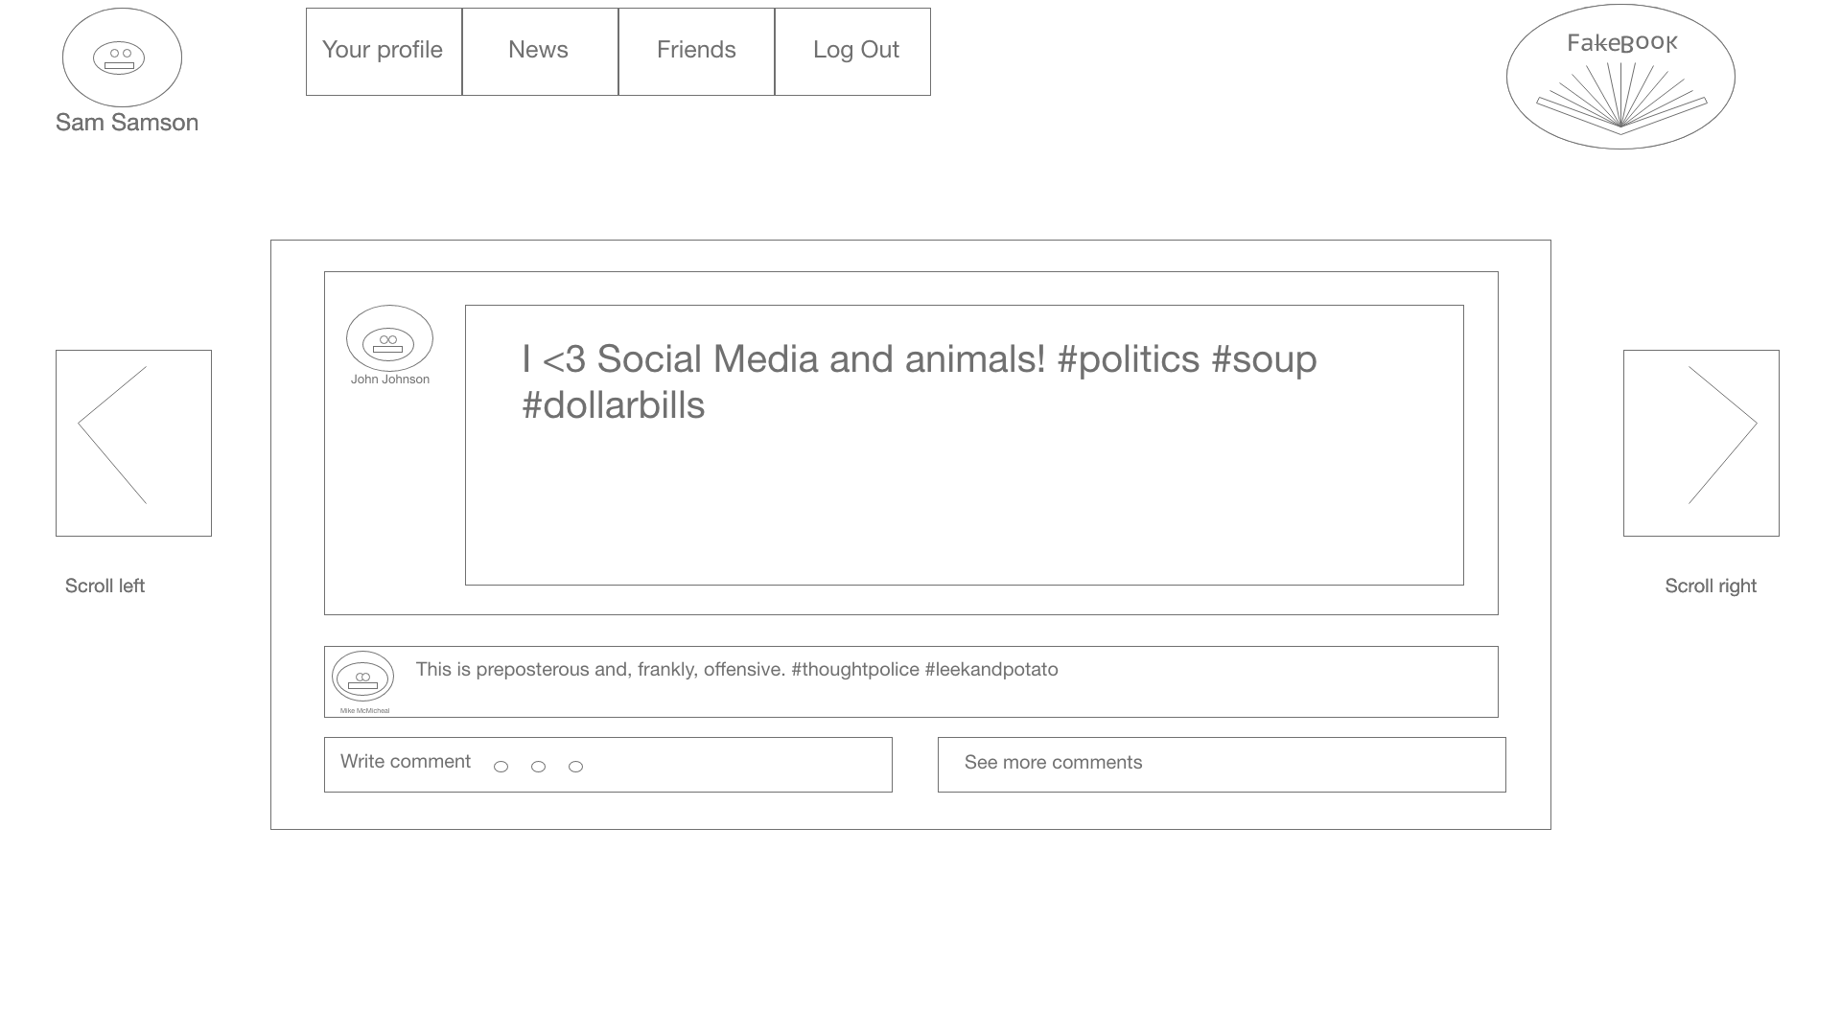
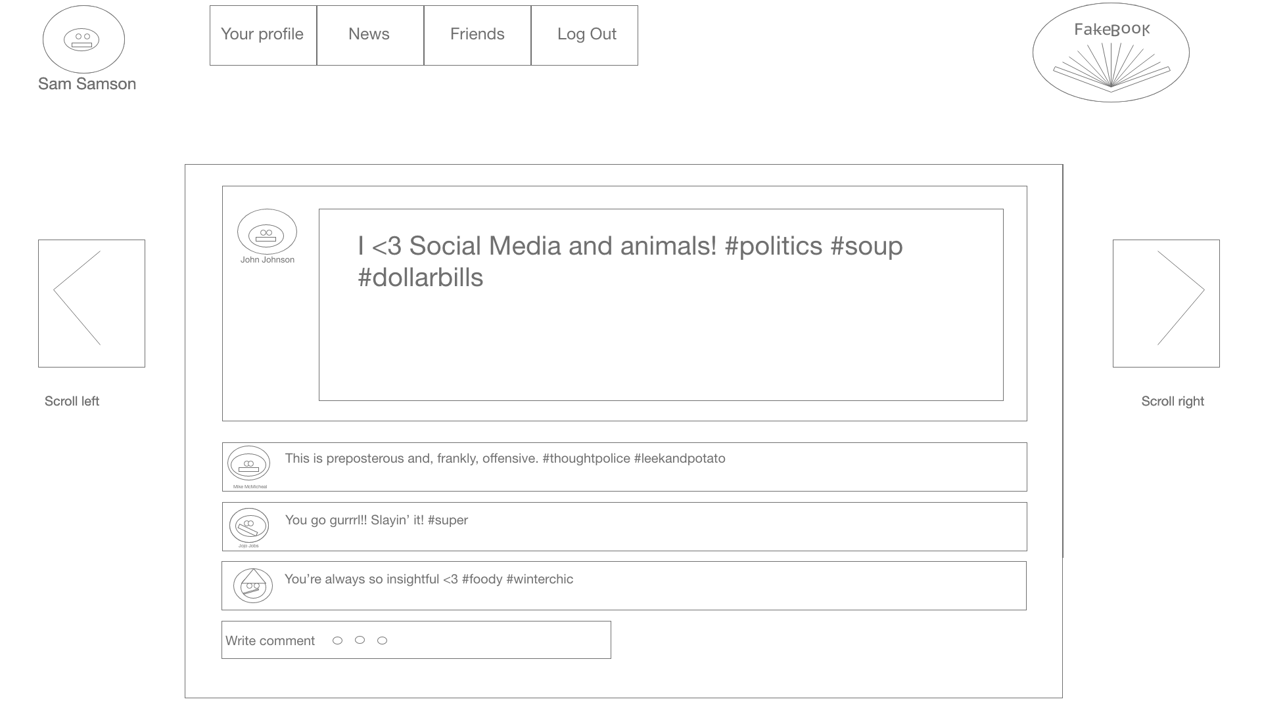
Sideways Scroll Layout
Explore new posts by scrolling left/right
Expanded comment section

Slide 9
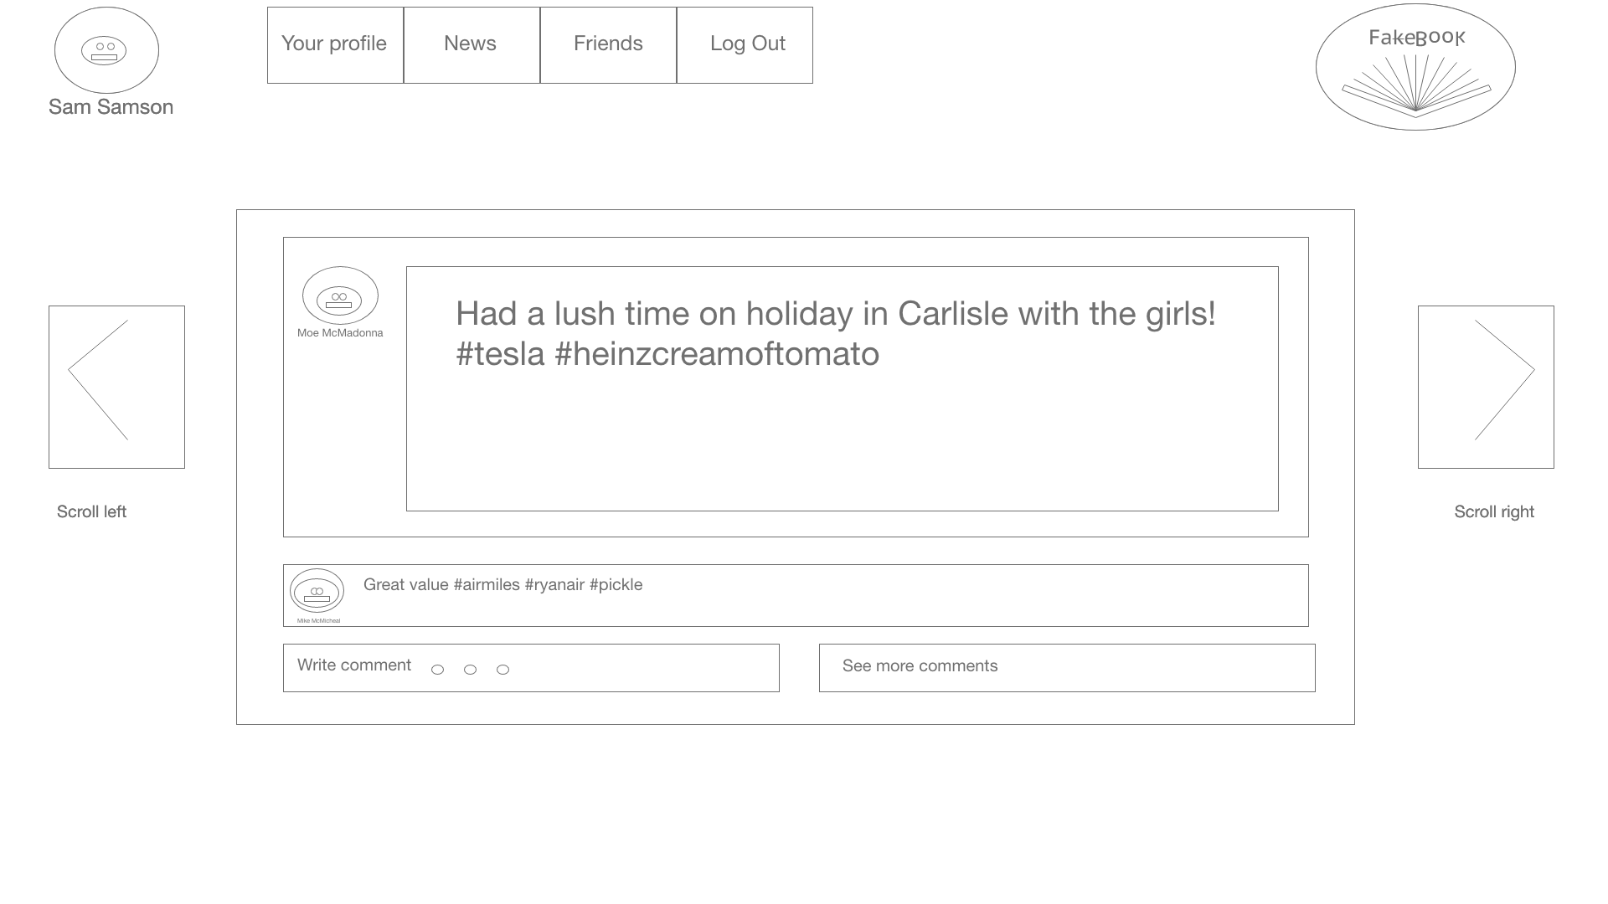
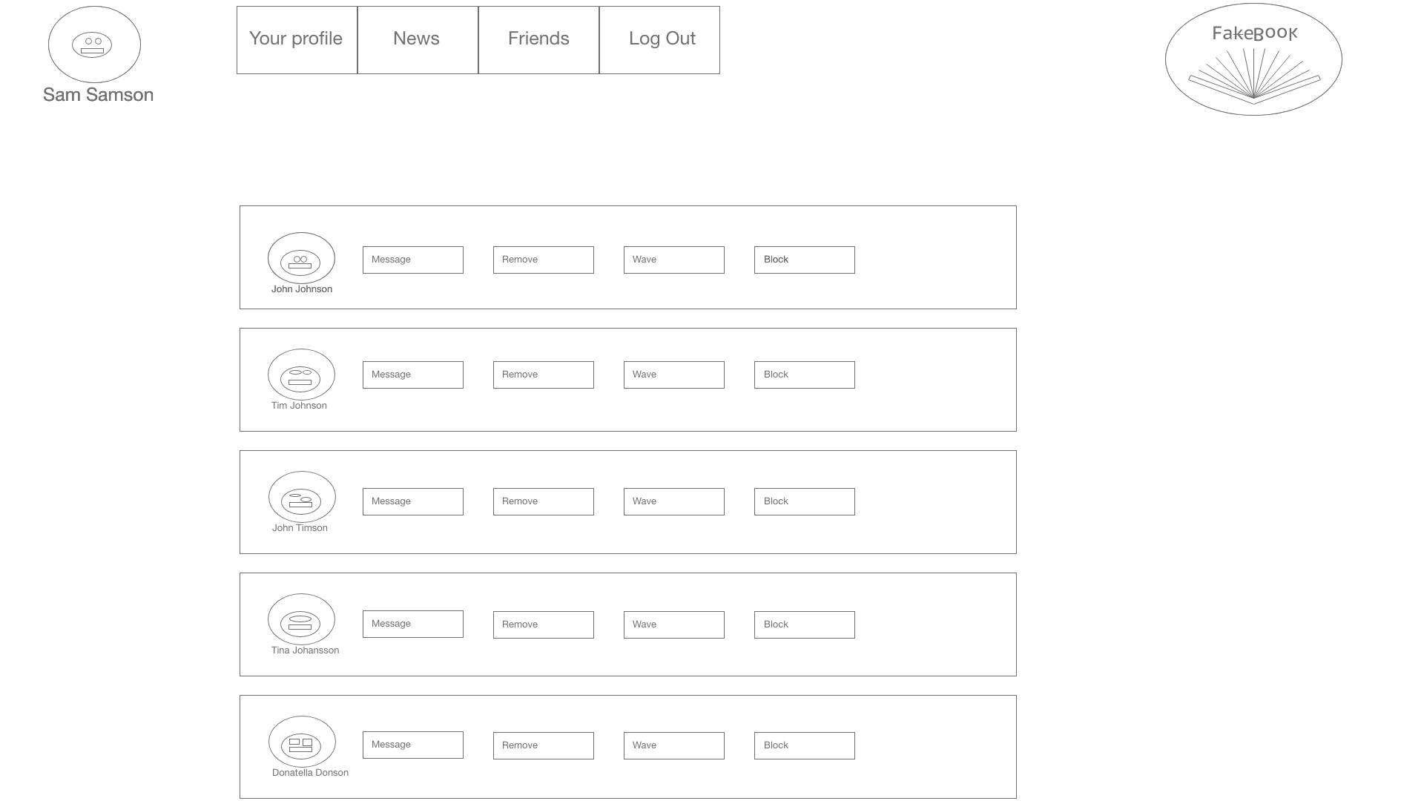
Sideways Scroll Layout
After scrolling to another post
Friends list

Slide 10
Sideways Scroll Layout
Pro’s:
Simple enough to be intuitive and obvious how a user should interact with it.
Familiar interaction mechanisms due to similarities to Tinder etc
Probably fairly straightforward to implement
Fake friend list is funny. Love it
Con’s:
Possibly dull
Perhaps detracts from the point we are trying to make about the big social media sites (eg Facebook, Twitter, Instagram) by not having the same vertically scrolling timeline
Not very playful or engaging
The comments unfolding from the bottom of the bubbles is possibly not very aesthetically pleasing based on feedback I received
Feedback:
Ends up in a weird middle ground as not very playful and also not similar enough to the big social media platforms.
Very Traditional (in a good way) which allows users to quickly become accustomed to the webpage, though to use a system like this I would propose some unique attributes. The navigation is good, in that it is straightforward, though reading posts could be a little slow and cumbersome.

Slide 11
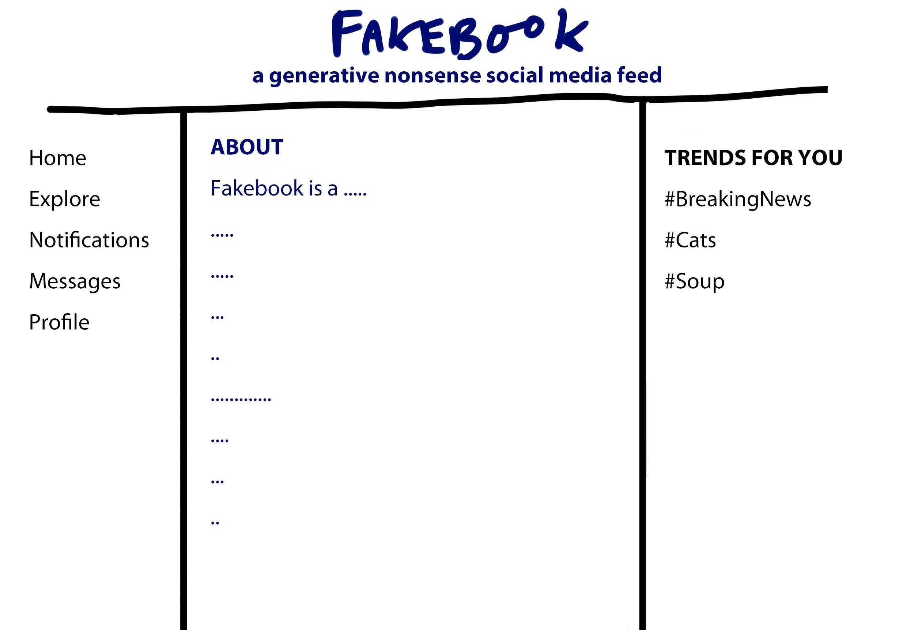
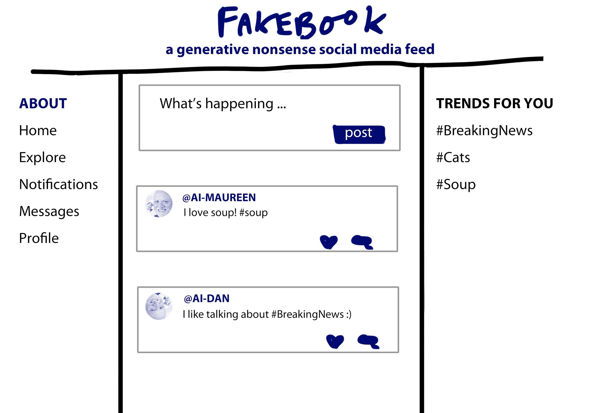
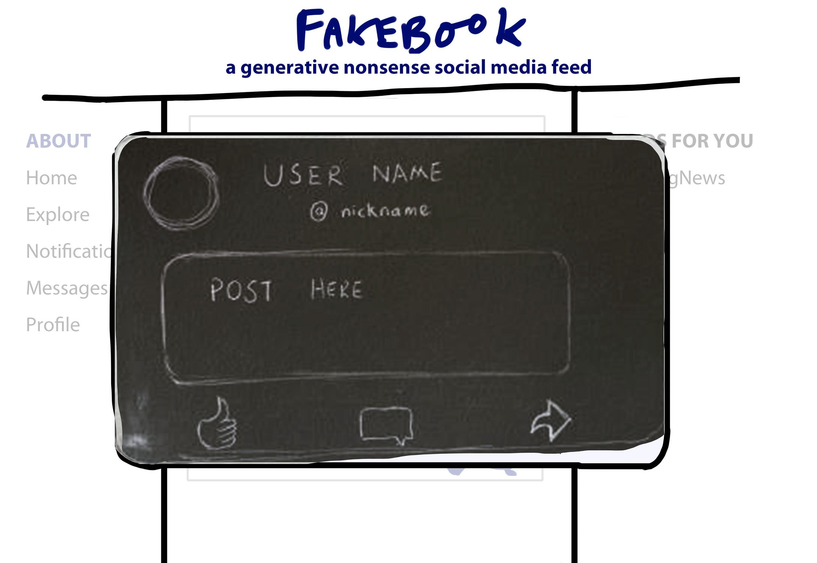
Classic layout

Slide 12
Classic Layout
Pro’s:
This design has a very clear relationship with ‘classic’ social media interfaces. It references the wireframe design of websites like Twitter and Facebook in a way that makes it very obvious to anyone familiar with those sites what the page is and how they should interact with it.
+familiarity
+a very simple and clear design
Con’s:
-perhaps a missed opportunity in terms of implementing novel interfaces to help make a point?
Looks too much like twitter
Feedback:
Really hammers home the fact that we’re making a parody of the big social media sites, therefore maybe is the best layout in terms of impact of our serious element. Would probably be straightforward to make. However not that fun or engaging, so maybe not so good on the playfulness front.

Slide 13
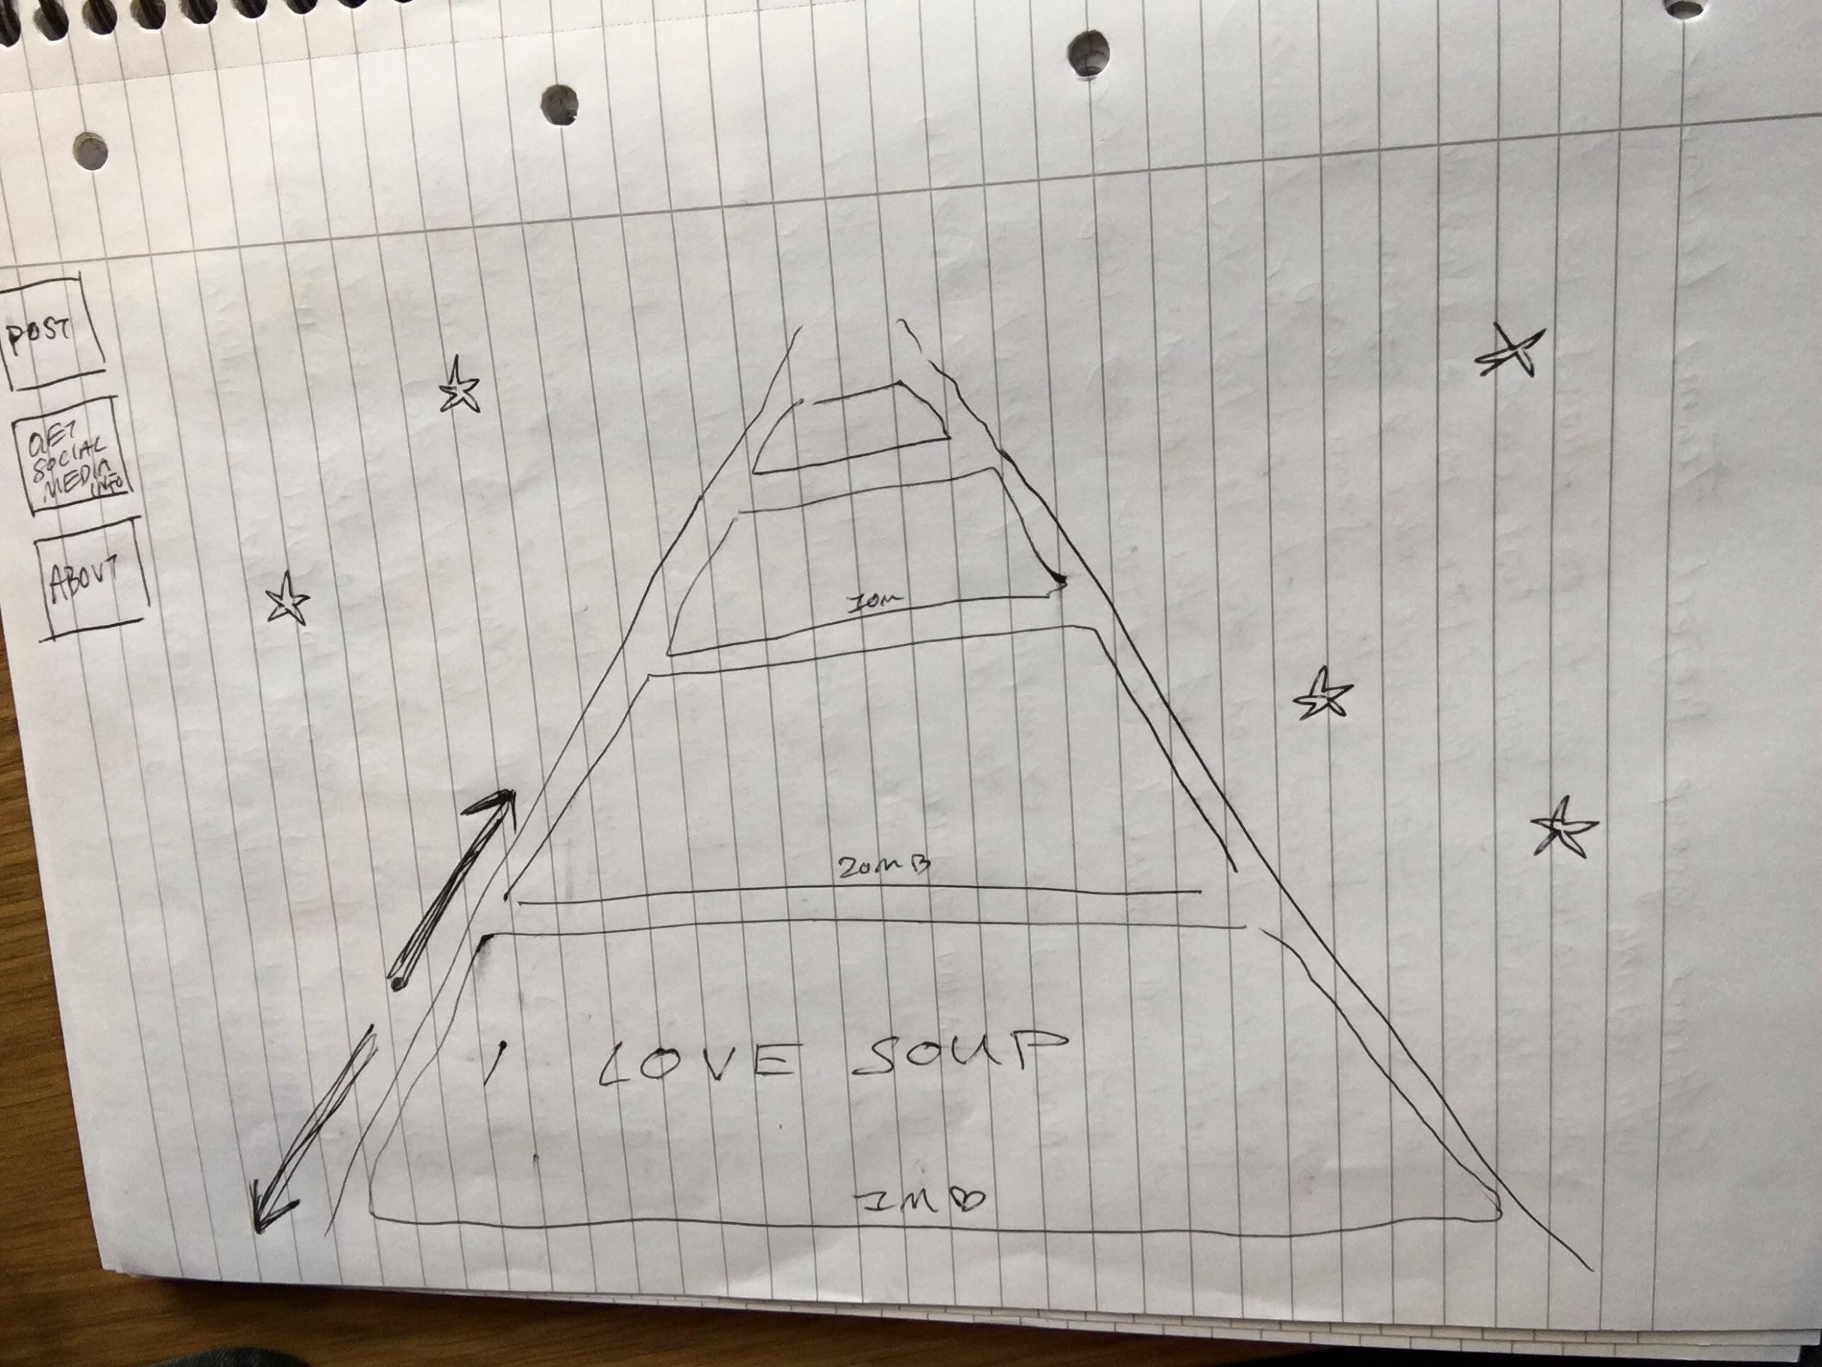
Star Wars Layout

Slide 14
Star Wars Layout
Pro’s:
The design contains a novel interface which creates a visualisation of the ‘infinite’ nature of a lot of social media interfaces. By changing the layout to draw attention to the ‘infinite’ scroll, the key concept of the website is able to have a very immediate visual presence on the page.
+visually impactful, novel, playful
Can name it Spacebook (so won’t get sued by Facebook)
Con’s:
-difficulty of implementation
-a less obvious relationship with a classic social media site
-we need to make careful decisions about where to implement the other features of the page- i.e allowing the user to post, giving facts about social media
-I showed it to people and they said it was weird and they wouldn’t know how to interact with it
+but they were also intrigued B)
Feedback:
Really fun and playful! I’m a sucker for Star Wars. I also like the fact that it plays with the idea of the infinite scroll which could help make our point?

